Slide 2
LEARNING OBJECTIVES
To understand the importance of the management team in launching a new venture
To understand the advantages and disadvantages of the alternative legal forms for organizing a new venture
To explain and compare the S corporation and limited liability company as alternative forms of incorporation

Slide 3
LEARNING OBJECTIVES
Contd…
To learn the importance of both the formal and the informal organization
To illustrate how the board of directors or board of advisors can be used to support the management of a new venture
To understand what difficulties may arise when owners are reluctant to delegate or give up responsibility

Slide 4
LEGAL FORMS OF BUSINESS
Proprietorship
Single owner, unlimited liability, controls all decisions, and receives all profits
Partnership: Two or more individuals who:
Pool resources to own a business
Have unlimited liability
Corporation: Legal entity that is run by stockholders having limited liability

Slide 5
LEGAL FORMS OF BUSINESS
Contd…
C corporation
Common form of corporation
Regulated by statute
Treated as a separate legal entity for liability and tax purposes
New forms of business formations
Limited liability company (LLC)
Limited liability partnership (LLP)
S corporation

Slide 6
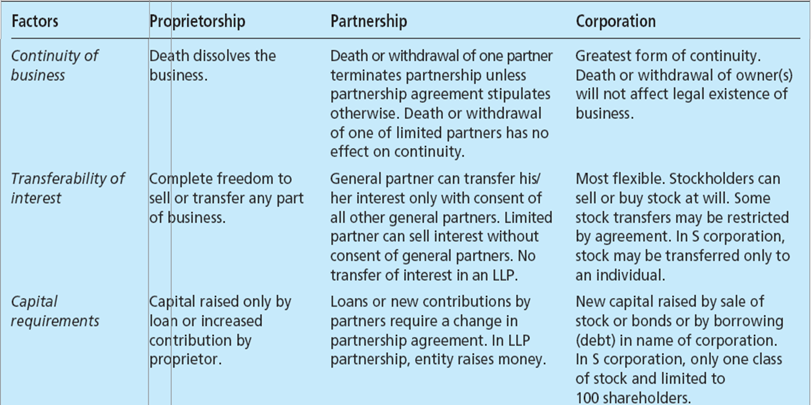
THREE FORMS OF BUSINESS FORMATION TABLE 9.1

Slide 7
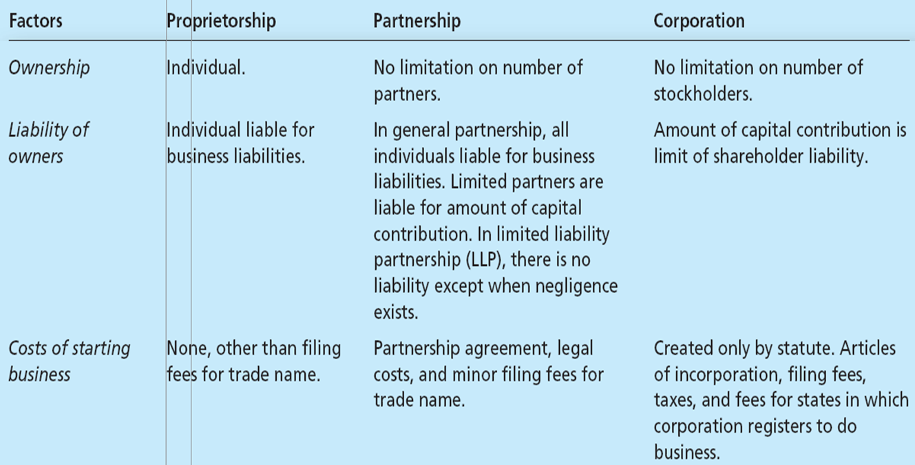
THREE FORMS OF BUSINESS FORMATION TABLE 9.1
Contd…

Slide 8
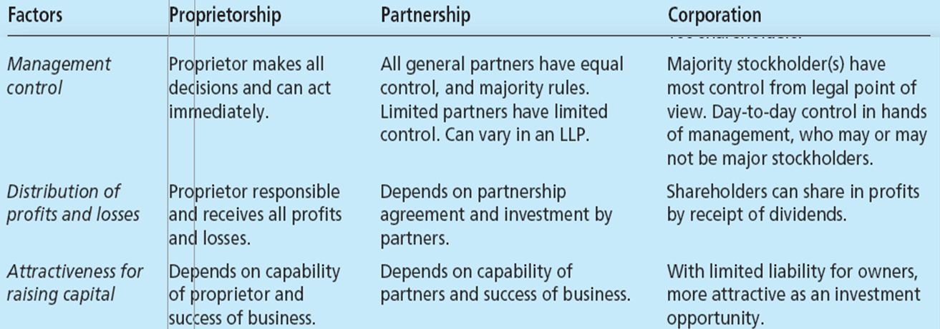
THREE FORMS OF BUSINESS FORMATION TABLE 9.1
Contd…

Slide 9
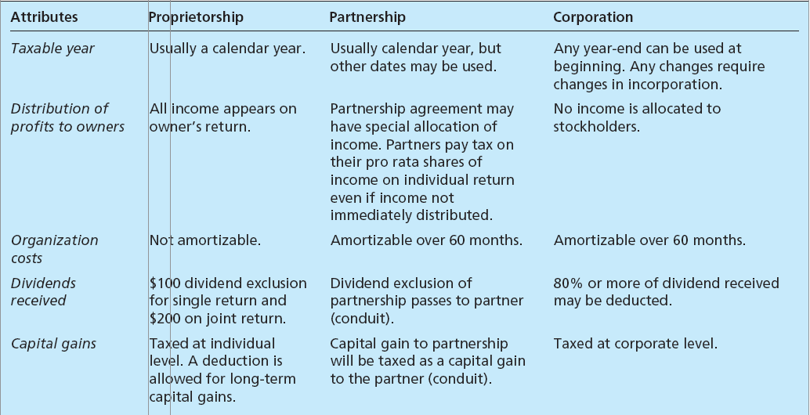
TAX ATTRIBUTES OF VARIOUS LEGAL FORMS OF BUSINESS TABLE 9.2

Slide 10
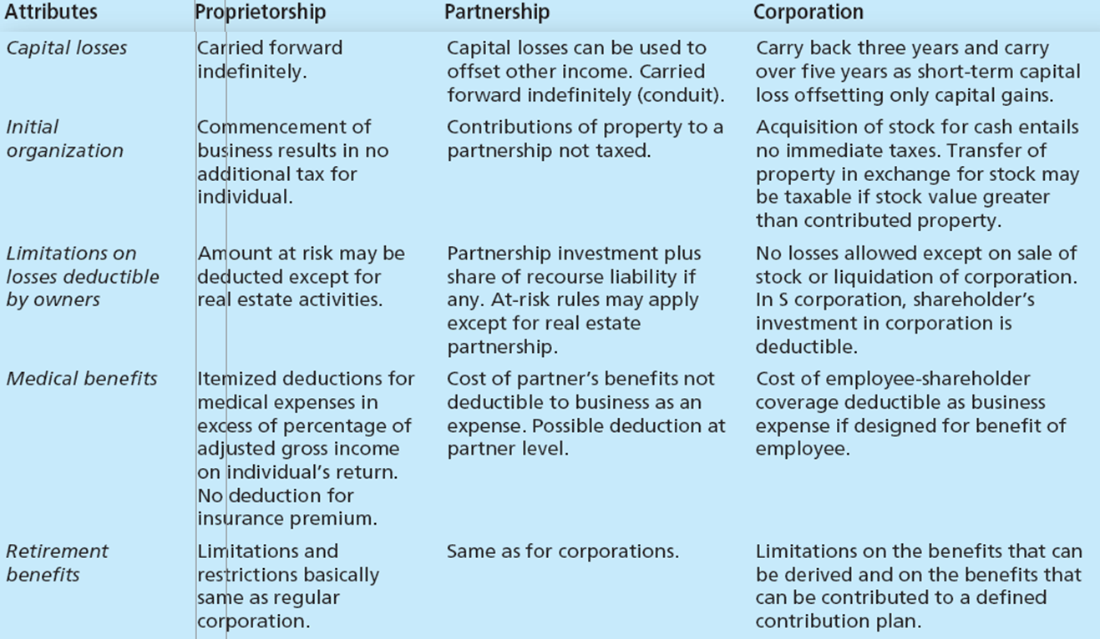
TAX ATTRIBUTES OF VARIOUS LEGAL FORMS OF BUSINESS TABLE 9.2
Contd…

Slide 11
S CORPORATION
Profits are distributed to stockholders and taxed as personal income
Advantages
Capital gains or losses are treated as personal income or losses
Limited liability protection
Not subject to a minimum tax
Transfer of stock to low-income-bracket family members

Slide 12
S CORPORATION
Contd…
Disadvantages
Restrictions for qualification
Potential tax disadvantages
Most fringe benefits not deductible for shareholders
Stock may be voting or nonvoting
Cash method of accounting
Long-term capital gains and losses are deductible directly by the shareholders

Slide 13
S CORPORATION
Contd…
Must have a calendar year for tax purposes
Only common stock is permitted
Net loss is limited to shareholder’s stock plus loans to business
No more than 100 shareholders

Slide 14
THE LIMITED LIABILITY COMPANY
Is partnership-corporation hybrid
Has members
Shares of stock not issued
Liability is limited to member’s capital contribution

Slide 15
THE LIMITED LIABILITY COMPANY
Contd…
Transfer of interest requires unanimous consent
Taxed as a partnership
Standard acceptable duration - 30 years

Slide 16
THE LIMITED LIABILITY COMPANY
Contd…
Advantages of LLC
Shares of the LLC liabilities can be added to partnership interests
Most states do not tax LLCs
No limit on number of entities forming LLC
Members share income, profit, expense, deduction, loss and credit, and equity

Slide 17
DESIGNING THE ORGANIZATION
Design of the organization
Formal and explicit indication to the members of the organization regarding what is expected
Organizational expectations can be grouped into:
Organization structure
Planning, measurement, and evaluation schemes
Rewards
Selection criteria
Training

Slide 18
BUILDING THE MANAGEMENT TEAM AND A SUCCESSFUL ORGANIZATION CULTURE
Management team must be able to:
Execute the business plan
Identify fundamental changes in the business as they occur
Make adjustments to the plan to maintain profitability

Slide 19
BUILDING THE MANAGEMENT TEAM AND A SUCCESSFUL ORGANIZATION CULTURE
Contd…
Important factors in establishing an effective team
Match between culture and business strategy
Motivation and reward for good work
Flexibility to try different things
Carefully planned hiring process
Communicate core values
Provide appropriate tools to effectively complete jobs

Slide 20
THE ROLE OF A BOARD OF DIRECTORS
Reviewing operating and capital budgets
Developing longer-term strategic plans
Supporting day-to-day activities
Resolving conflicts among owners or shareholders

Slide 21
THE ROLE OF A BOARD OF DIRECTORS
Contd…
Ensuring the proper use of assets
Developing a network of information sources
Meeting criteria laid by the Sarbanes-Oxley Act

Slide 22
THE BOARD OF ADVISORS
Serve only in an advisory capacity
No legal status
Likely to meet less frequently
Useful in a family business
Compensated on a per-meeting basis or with stock options

Slide 23
THE ORGANIZATION AND USE OF ADVISORS
Used on an as-needed basis
Separate from the formal board of advisors
Can become a part of the organization and need to be managed

